Slide 1
.
Student name : j.aradhana
register no : 222403410
nm id : fce31de037da69da240432ab1053f5
department : b.sc computer science
college : thirumurugan arts and science college for women tirupachur
tiruvallur district –631 203
university : madras university

Slide 2
Earth quake

Slide 3
Earth quake
Introduction:
An earthquake is the sudden shaking of the earth’s surface.
Caused by the movement of tectonic plates beneath the earth’s crust.
Can lead to damage, loss of life, and natural changes.

Slide 4
Earth quake
Causes of earthquakes:
Tectonic movements - shifting of plates.
Volcanic activity – pressure from magma.
Man made causes - mining, dams, nuclear tests.

Slide 5
Earth quake
Types of seismic waves:
P-waves (primary waves): fastest, travel through solids & liquids.
S-waves (secondary): slower, only through solids.
Surface waves: cause most destruction on earth’s surface.

Slide 6
Earth quake
Measurement of earthquakes:
Richter scale - measures magnitude (strength).
Seismograph- instrument used to detect vibration.
Mercalli scale – measures intensity of damage.

Slide 7
Earth quake
Effects of earthquakes:
Destructive:
Collapse of building & bridges.
Tsunamis & landslides
Loss of life & economy
Constructive:
Formation of mountains.
Release of underground resources.

Slide 8
Earth quake
Safety measures:
Before: build earthquake-resistant structures.
During: 1.drop, cover, hold.
2.stay away from window/heavy object
After: 1.check for injuries & gas leaks
2.follow emergency services.

Slide 9
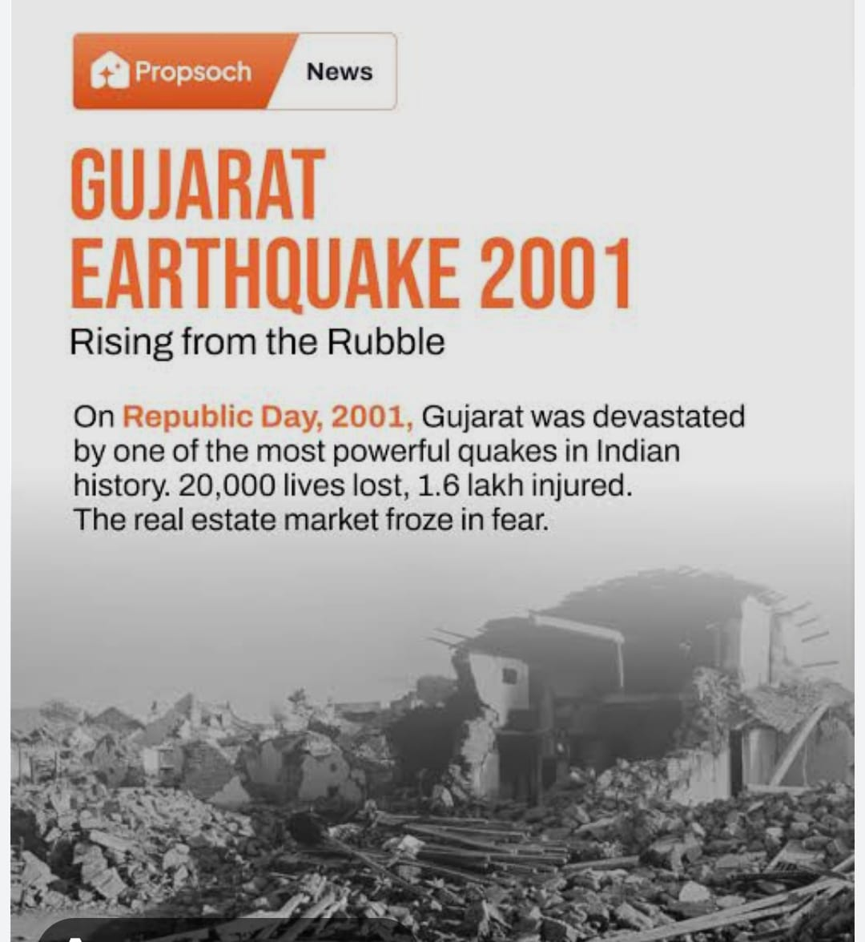
Earth quake
Case studies:
2001 Gujarat earthquake (india): 20,000+ deaths.

Slide 10
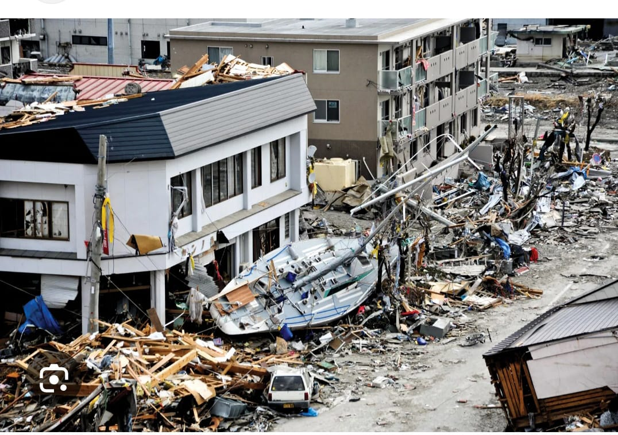
Earth quake
2011 japan earthquake: triggered tsunami & nuclear crisis.

Slide 11
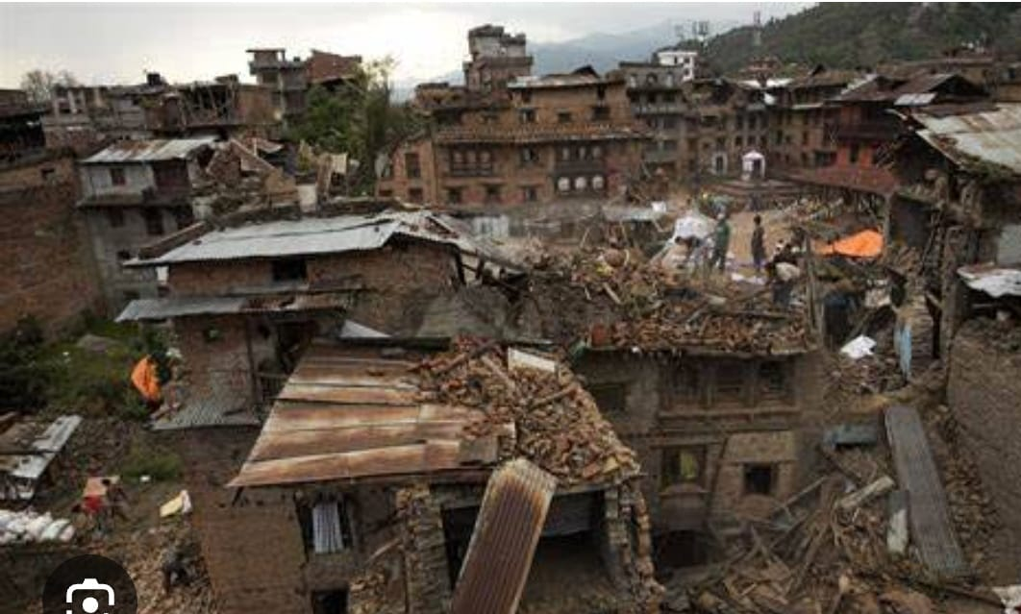
Earth quake
2015 Nepal earthquake: huge destruction in kathmandu

Slide 12
Earth quake
Conclusion:
Earthquakes are unpredictable but manageable.
Preparedness &awareness can reduce damage and save lives.
“we cannot stop earthquakes, but we can learn to live safely with them,”

